Slide 1

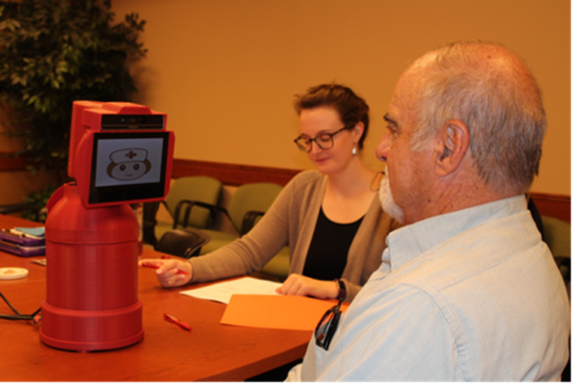
INTELLIROBOT
Innovation for a Better Quality of Life

Slide 2

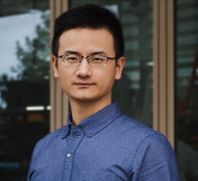




MEET OUR TEAM!
Zhidong Su
Fei Liang
Andrew Karaoulis
Chinmayi Rane
CEO
CTO
CFO
CPO
PhD, Elderly Care Fields
PhD, Elderly Care Fields
MS, Finance & Accounting Expert
MS, Analytics & Product Management Expert
Notes:
Andrew - Good copy. Keep this slide.

Slide 3

BUSINESS THESIS
The IntelliRobot team is in the process of creating a smart Elderly Care Companion Robot designed to enhance communication between older adults and their caregivers, promoting a safer and healthier lifestyle.

Slide 4

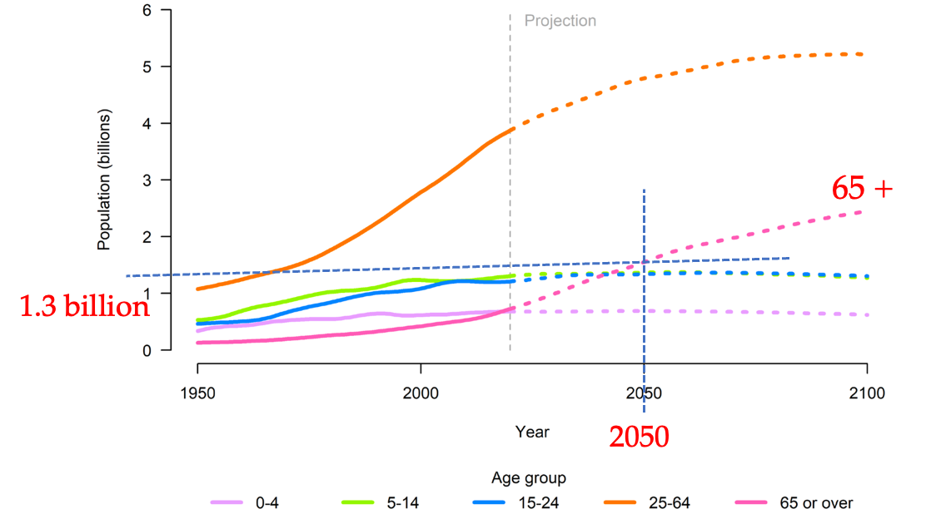
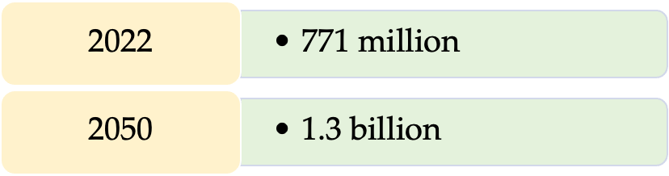
Background
Elderly population in the world

Slide 5
Cost for Elderly Care
Average monthly costs of nursing home care - $7,000
Average monthly assisted living cost - $4,700
Average monthly full time caregiver salary - $4,500

Slide 6
Existing Problems in Elderly Care
Older adults
Forget to take medicine
Fall down
…
Caregivers
Visit frequently in person
Cannot provide timely assistant (Night time)
…
Reduce benefits of treatments
Threaten life safety
A lot of workload
Low work efficiency

Slide 7
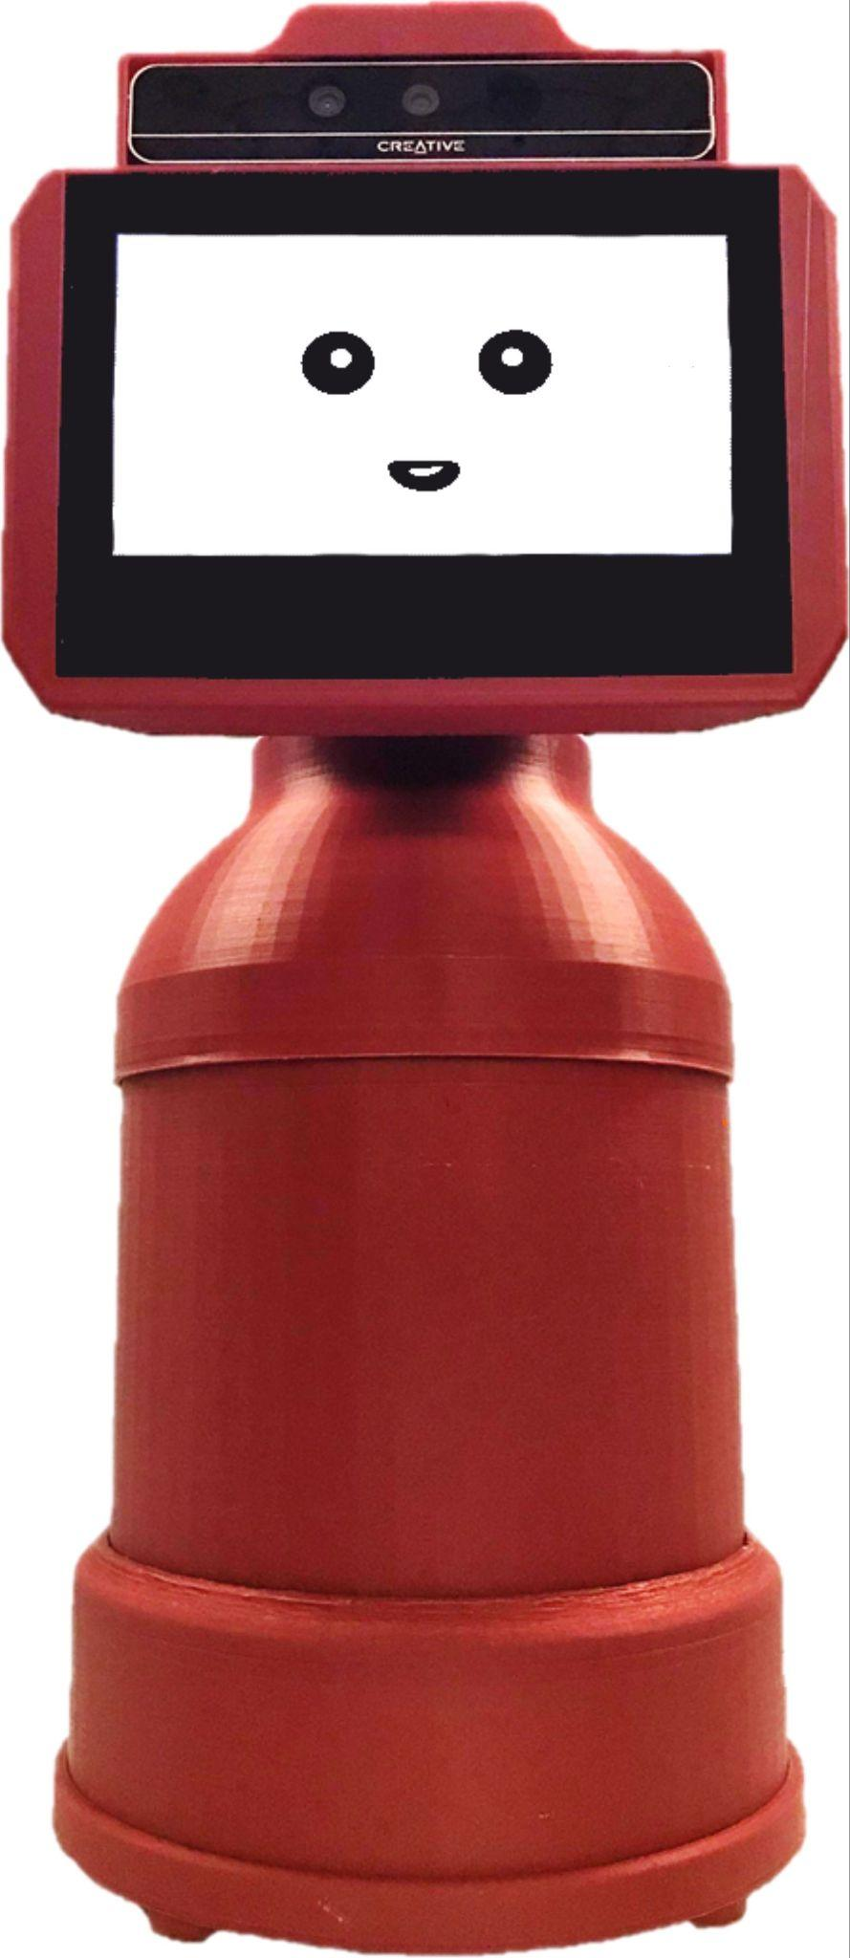
OUR SOLUTION!
Messaging
Voice based messaging
Social networking
Photo taking and sharing
Daily life management
Scheduler
Medication reminder
ADL reminder
Companionship: music, joke, checking general well-being
Health monitoring and emergency response
Coughing
Fall detection
Pain level
Distress
Vital signs
Teleconferencing with caregiver
Privacy protection
AI algorithm
Health Care Platform

Slide 8
BUSINESS MODEL
Selling Unit | Robot + Monthly subscription
Customers | Nursing homes, hospitals, old age facilities, individual caregivers and family members
Manufacturers | Shenzhen Reeman Intelligent Equipment Co., Ltd. Jiangxi Hengbida Co., Ltd.
Price | Unit: $5,000 Subscription: $50/$200 (for businesses)

Slide 9

Market
Older adults: 55.8 million +
Nursing homes: 26,000 +
$292 Billion
Notes:
5000*55.8*1,000,000+26000*100*5000

Slide 10
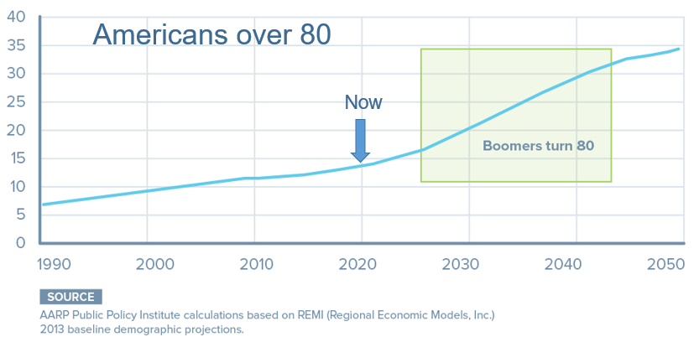
Market
Population: 55.8 M(2020) -> 80.8 M(2040)
1.25% per year

Slide 11
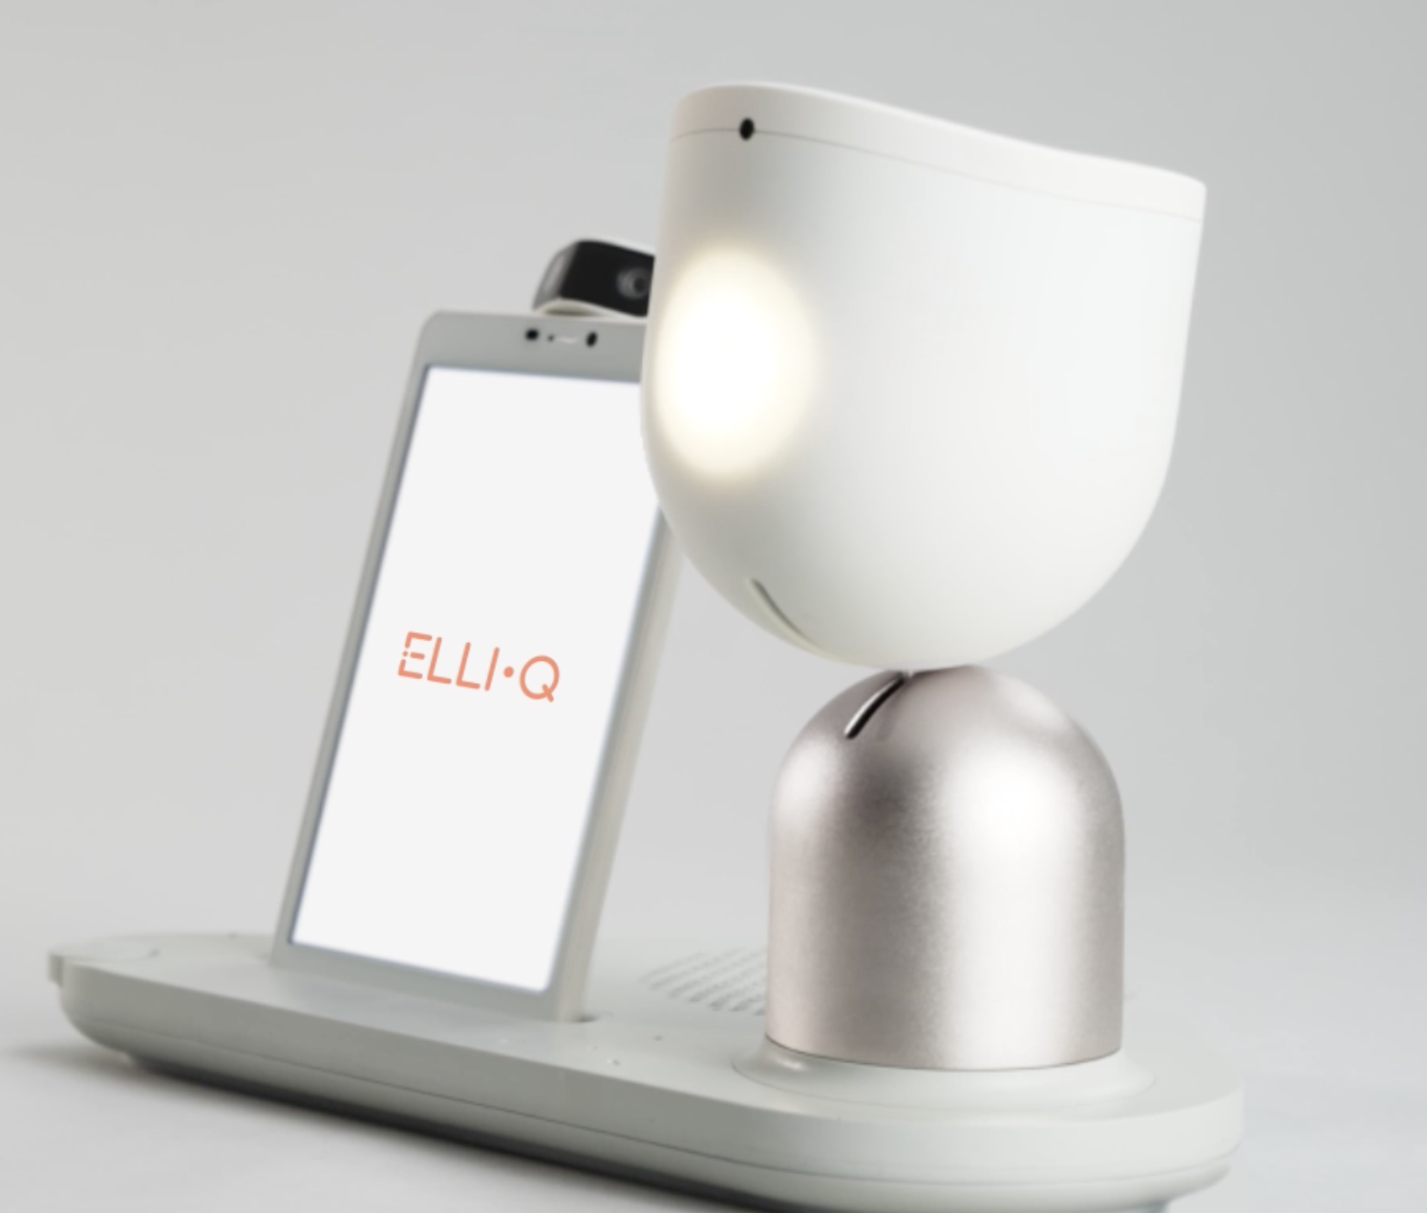
Competition
ElliQ robot
Founded in 2016
Raised nearly $83 million
Price:
$250 per unit
$30 per month/subscription

Slide 12
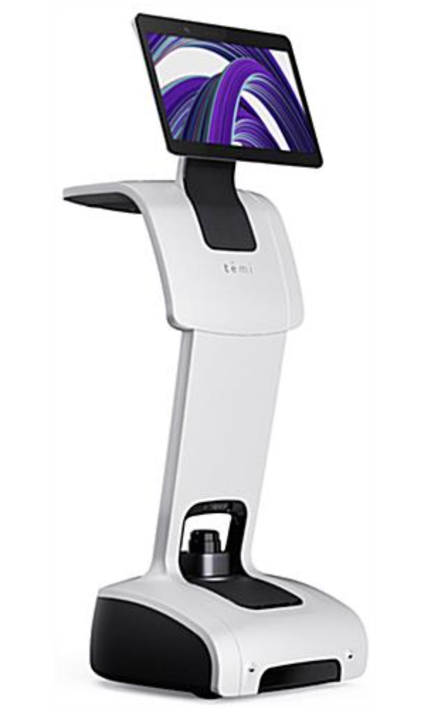
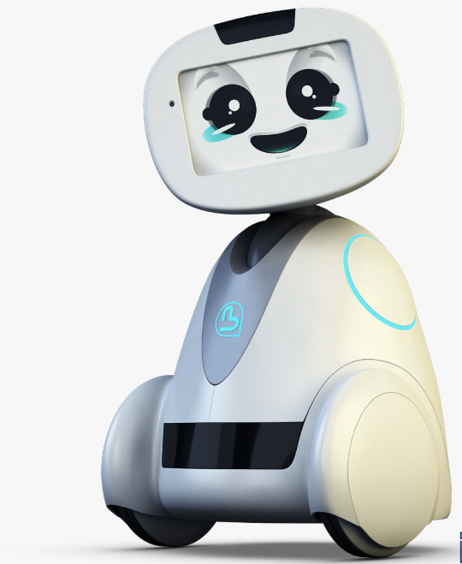
Competition
Temi robot
Buddy robot
Founded in 2016
raised nearly $21 million
Price:
$4000 per unit
Founded in 2014
$600k (2015)
$2 million needed to ship 1000 robot (2020)
Price:
$4890 per unit

Slide 13
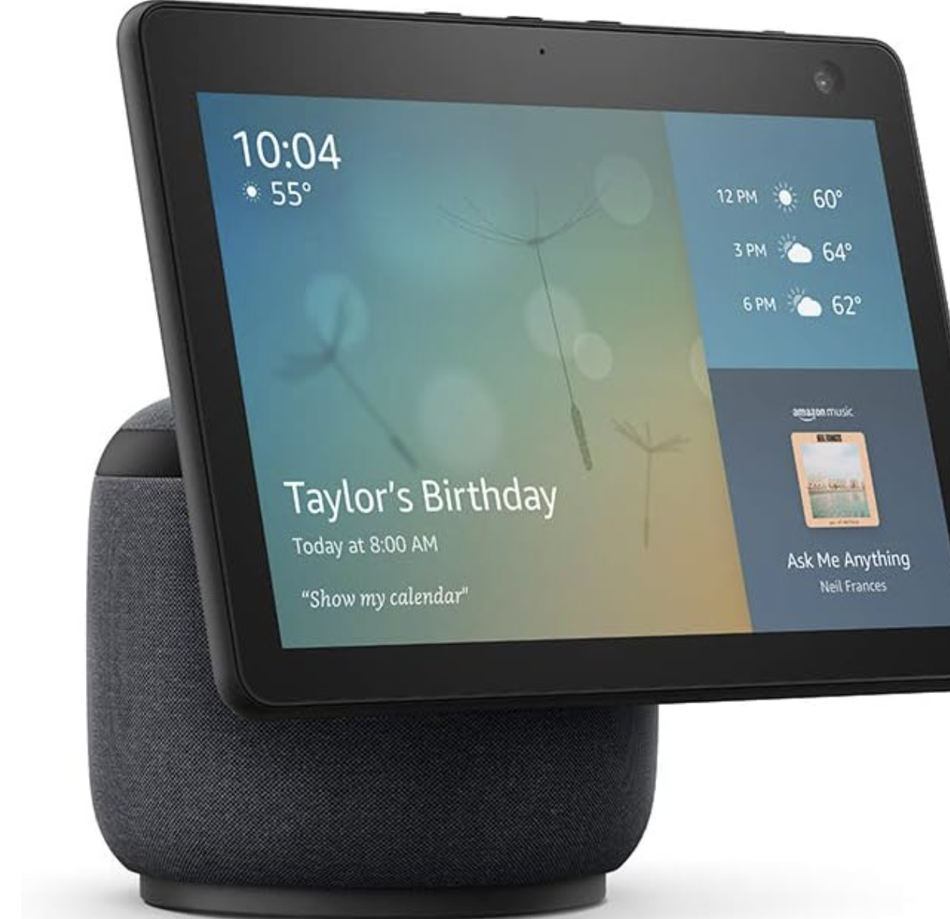
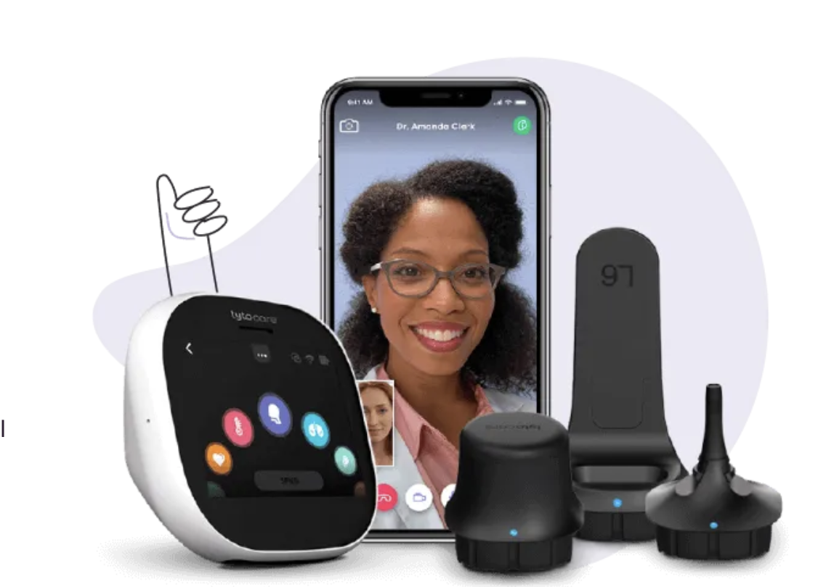
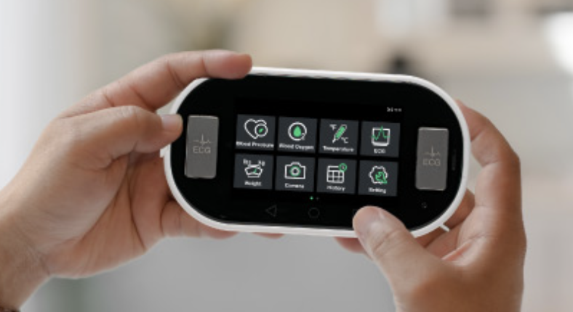
Competition
Echo show
VITAL S360
Tyto Home

Slide 14

Competition
Products | ADL | Physical wellbeing assessment | Subjective wellbeing assessment | Health coaching | Daily life management | Telehealth | movability
ElliQ
Temi
Buddy
Echo show
VITAL S360
Tyto Home
IntelliRobot

Slide 15
LifeTime Value
 | Year 0 | Year 1 | Year 2 | Year 3 | Year 4 | Year 5
Net Present Value | $4500 | $402 | $264 | $180 | $120 | $79
LifeTime Value | $5545 (For each unit)
Notes:
Subscription + Unit cost

Slide 16
Customer Acquisition Cost
 | Year 1 | Year 2 | Year 3 | Year 4 | Year 5
New customers forecasted | 0 | 150 | 350 | 800 | 1500
All sales expenses for period | - | $70,000*4 | $70,000*8 | $70,000*15 | $70,000*25
All marketing expenses for period | - | $40,000 | $80,000 | $80,000 | $100,000
Total marketing and sales expenses for period | - | $320,000 | $640,000 | $1,130,000 | $1,830,000
CoCa for the period | - | $2133.3 | $1828.6 | $1412.5 | $1220.0

Slide 17
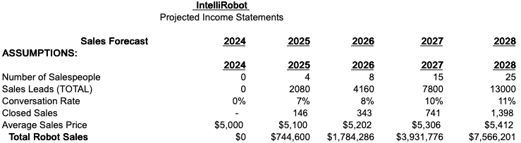
Sales - Bottom’s Up
0 to 25 sales people over 5 years
7-11% closing rate
2080 leads in 2025 resulting in 146 sales
Notes:
Andrew - Good copy. Keep this slide.

Slide 18


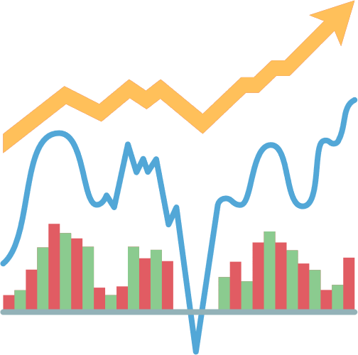
WHY OUR TEAM?
DATA
ANALYTICS
TECHNOLOGY
FINANCE

Slide 19








IN-SOURCE
OUT-SOURCE
FINANCE
MANUFACTURING
PRODUCT MANAGEMENT
Design, Development, Testing
LEGAL
SALES
RESEARCH LABS
(ASCC LAB)
HUMAN RESOURCES

Slide 20

SOURCE
NSF, NIH
Seed round
Series A, B, and C
LEVERAGING THE
CAPITAL
UTILIZATION
Training
Marketing
Product manufacturing
Office spending
Salaries

Slide 21
DEVELOPMENT MILESTONES
Description | 2023 | 2024 |  |  |  | 2025 |  |  |  | 2026
 | 4 | 1 | 2 | 3 | 4 | 1 | 2 | 3 | 4 | 1 | 2 | 3 | 4
Intellectual Property Protection
Production of Prototypes | V1 |  |  |  |  | V2 |  |  |  | V3
Prototype Testing |  |  |  | V1 & V2 |  |  |  |  | V3 & V4
$500 K Seed Round
VC Round
Production Manufacturing |  |  |  | V1 |  |  |  | V2 |  |  |  | V3
Marketing and Sales
Positive Cash Flow

Slide 22
FINANCIAL PROJECTIONS
 | 2024 | 2025 | 2026 | 2027 | 2028
REVENUE | $0 | $757,490 | $1,899,257 | $4,276,598 | $8,386,381
TOTAL COGS | $0 | $272,786 | $683,733 | $1,539,575 | $3,019,097
GROSS PROFIT | $0 | $484,954 | $1,215,525 | $2,737,023 | $5,367,284
OPERATIONS | $575,768 | $766,231 | $941,498 | $1,581,176 | $2,495,566
NET PROFIT | ($575,768) | ($281,278) | $274,026 | $1,155,846 | $2,871,718
Notes:
Andrew - Good copy. Keep this slide.

Slide 23



CURRENT FUNDING
USE OF FUNDS
NIH : $550,000
STIPEND & OFFICE SPENDING
ADDITIONAL FUNDING
PRODUCT MANAGEMENT
Seed Round*
Series A, B and C
Manufacturing
Prototype Production & Testing
Hardware & Software Development
*Offering 30% Equity
for $1,000,000
MARKETING & SALES
Notes:
Andrew - Good copy. Keep this slide.

Slide 24
Valuation / Investor Return
Selling 30% equity for $1,000,000
Year 5 Net Income: $2.87M * 8x multiple = $22.97M Valuation
30% equity stake valued at $6.89M
Represents a 5.9x equity multiple and 47% IRR
EXIT STRATEGY: IPO or Acquisition
Notes:
Andrew - Good copy. Keep this slide.

Slide 25
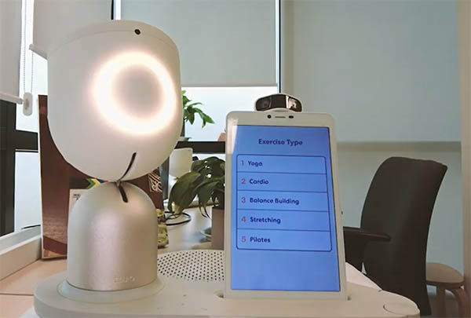
POTENTIAL ACQUIRERS
ElliQ
Founded 2016, $83 Million
Test 800+ robots in New York City
Temi
Founded 2015, $105 Million
Products in the market
Elderly care field

Slide 26

TIME AND MONEY SPENT
ACCOMPLISHMENTS
Development
Built the prototype
Tested the robot among 100 users
Patents
File the disclose of the Intellectual Property
7 years
$800,000 NSF fundings
6 PhDs

Slide 27



RISK ASSESSMENT
COMPETITION
ADOPTION RATE
KEY CUSTOMERS

Slide 28
Aggressive marketing campaigns
Build strong brand presence
Collaborate with healthcare professionals
Diversify the customer base
MITIGATION STRATEGIES
(Our ABCD!)

Slide 29
Highlights
Enables a safer/healthier life for older adults
Improves caregivers working efficiency
Up to $50,000 in annual labor cost savings
Massive Potential in the Aging Population
55.8M 65+, growing to 80M by 2040
60+ cohort will make up 22% of the population by 2050, nearly doubling from 12% currently
The roadmap is in place
Sell, grow, retain, and exit
CONCLUSION
Notes:
Andrew - Good copy. Keep this slide.

Slide 30

THANK YOU

